Slide 1
Week 4 – Understanding the Web Content Accessibility Guidelines (WCAG)
CST8914 - Accessible by Design

Slide 2
Weekly Outcome
Explain the WCAG structure and its levels of compliance
Interpret WCAG principles and give example for each
Identify potential accessibility defects on web pages and explain how they fit under the WCAG
Describe the how to perform a WCAG conformance evaluation

Slide 3
Lesson Overview (Agenda)
In the following lesson, we will explore:
How to filter the "How to Meet WCAG (Quick Reference)"
WCAG AA principles, guidelines and success criteria
Perceivable
Operable
Understandable
Robust
Reporting on WCAG conformance

Slide 4
How to filter the "How to Meet WCAG (Quick Reference)"

Slide 5
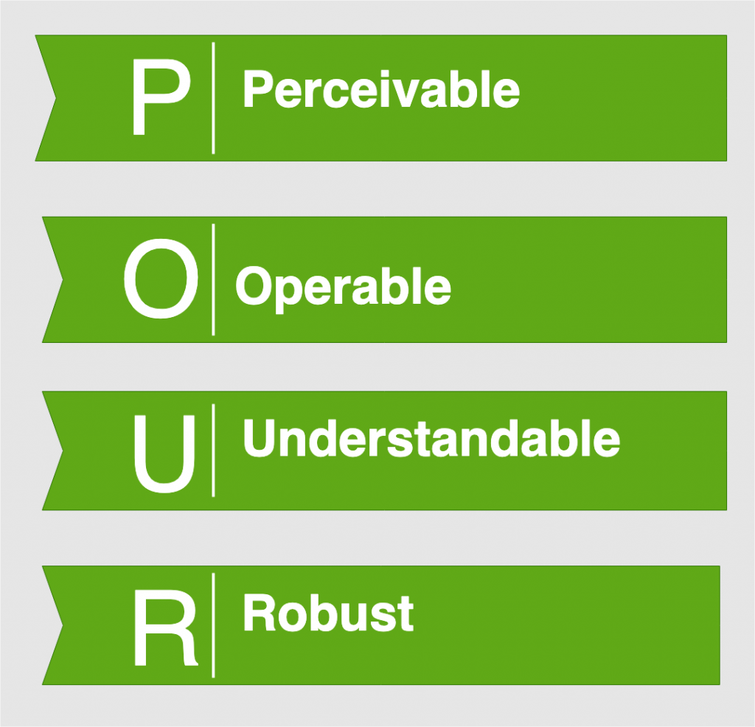
WCAG Principles
WCAG provides a detailed set of guidelines for making web content more accessible to people with a wide variety of disabilities.
WCAG is organized around four principles
Perceivable - Information can be presented in different ways; for example, in braille, different text sizes, text-to-speech, or symbols, etc.
Operable - Functionality can be used in different modalities; such as keyboard, mouse, sip-and-puff, speech input, touch, etc.
Understandable - Information and functionality is understandable; like consistent navigation, simple language, etc.
Robust - Content can be interpreted reliably by a wide variety of browsers, media players, and assistive technologies.
Graphic source: WCAG principles, Toronto Metropolitan University
Read more: Introduction to Web Accessibility, W3Cx WAI0.1x, edX / Watch video: Sip-and-puff in action, video (3min 55sec)
Notes:
The World Wide Web Consortium, or W3C, has established a body of guidelines for assessing web accessibility called the Web Content Accessibility Guidelines, or WCAG. These guidelines describe a set of detailed criteria you can use to test your website content for accessibility.

Slide 6
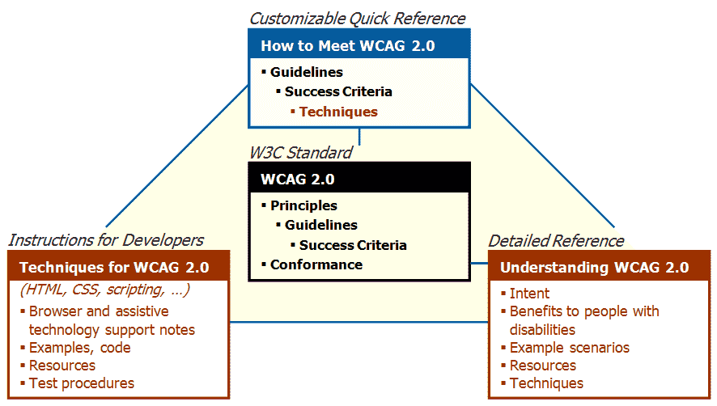
The structure of WCAG
Technique structure :
Applicability
Description
Examples
Resources
Related techniques
Tests
The WCAG diagram uses “WCAG 2.0” yet still applies for WCAG 2.1 and WCAG 2.2..
Advisory techniques are not required for conformance
Image source: The WCAG 2 Documents, W3C - Web Accessibility Initiative
Notes:
WCAG is designed to be technology-agnostic so that it applies to different technologies including HTML, CSS, and JavaScript, as well as many types of mobile apps, electronic documents, and other digital content.
WCAG 2.2
Principles (4)
Guidelines (13)
Success criteria (78) – (22 level A, 39 level AA, 17 AAA)
Sufficient techniques
Advisory techniques*
Common failures
Conformance requirements

Slide 7
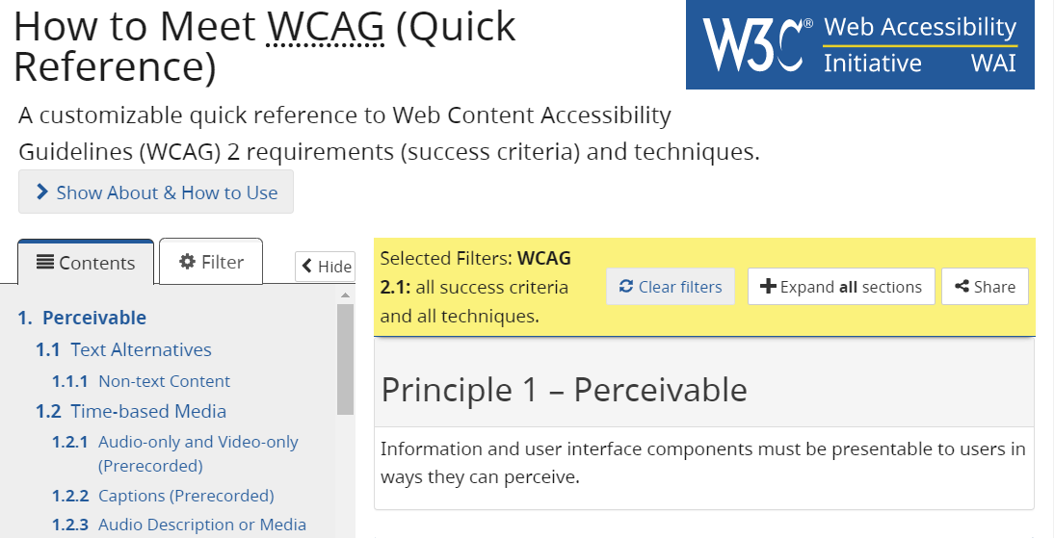
Demonstration: How to Meet WCAG (Quick Ref)
Learning objectives
Learn how filter & search within the WCAG documentation.
Confirm if a suspected violation is a true WCAG failure.
Learn techniques on how to fix a failure and
Assess the impact of a failure on people with disabilities.
Google “WCAG quick ref”
Customize for:
WCAG 2.1 AA
Web related techniques
Notes:
Note that
Each success criteria is organized into
Understanding - Explanation of the requirements, such as who it benefits and examples. It is a very useful resource to understand the rational.
Techniques & failures - Ways of meeting the Success Criteria as well as commonly encountered failures.
Technique Structure:
Applicability
Description
Examples
Resources
Related techniques
Tests

Slide 8
WCAG AA principles, guidelines and success criteria

Slide 9
Is the web page perceivable?
Information and user interface components must be presentable to users in ways they can perceive.
Do images have alternative text?
Is the tab order and read order logical and intuitive?
Have you avoided using visual characteristics to communicate information (e.g., “click the circle on the right” or “required fields are in red”)?
Does the interface have sufficient contrast between text color and background color?
Does the content scale well when text is enlarged up to 200 percent?

Slide 10
Is the web page operable?
User interface components and navigation must be operable.
Can all menus, links, buttons, and other controls be operated by a keyboard, to make them accessible to users who are unable to use a mouse?
Does the web page include a visible focus indicator so that all users, especially those using a keyboard, can easily track their current position?
Do features that scroll or update automatically (e.g., slideshows, carousels) have prominent accessible controls that enable users to pause or advance these feature on their own?
Do pages that have time limits include mechanisms for adjusting those limits for users who need more time?

Slide 11
Is the web page understandable?
Information and the operation of user interface must be understandable.
Can the language of the page, and any changes in language, be programmatically determined?
Is there enough information related to interactive elements for all users to be able to successfully interact with the page (including error handling)?
Do elements repeated across pages appear in the same relative order?
Does the content follow the Canada.ca Content Style Guide?

Slide 12
Is the web page robust?
Content must be robust enough that it can be interpreted reliably by a wide variety of user agents, including assistive technologies.
Can users determine the roles, states, and properties of custom elements?
Does the markup language use conform to the concept of being “well formed” according to its specification?

Slide 13

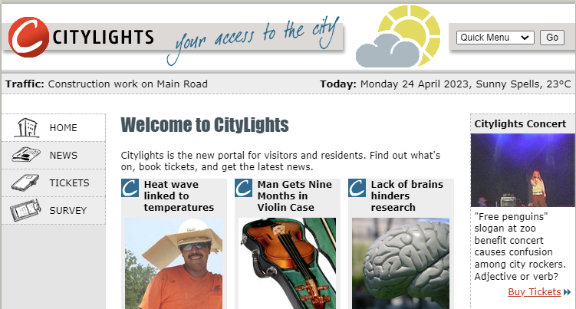

Activity: How to Meet WCAG (Quick Ref)
Complete the communication of WCAG failure below
H37: Using alt attributes on img elements
[Success criteria] 1.1.1: Non-text Content. under guideline Guideline 1.1:Text Alternatives
[What is the issue]
[Impacted users]
[What is the impact]
[Code snippet] <img src=“logo.gif” />
[The recommendation to fix the issue]
[Sample of compliant code]
[Screenshot]
logo.gif
Screenshot for the page with the logo

Slide 14
Reporting on WCAG conformance

Slide 15
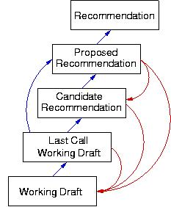
Web Content Accessibility Guidelines (WCAG)
Examples for WCAG involvement in policies, standards and regulations
Canada, Accessible Canada Act and Accessibility for Ontarians with Disabilities Act (AODA),
Europe, EN 301 549: European standard for digital accessibility,
The States, Section 508 US federal government.
Which WCAG version to follow?
WCAG 2.2, is a candidate recommendation (as of May 22).
WCAG 2.1 is the latest recommendation, June 2018 (13 Guidelines & 78 Success Criteria)
WCAG 2.0 is the previous recommendation, December 2008 (12 Guidelines and 61 Success Criteria)
W3C document recommendation process
Notes:
WCAG 2.0 vs. WCAG 2.1 vs WCAG 2.2 WCAG 2.1 includes 17 new success criteria beyond those in WCAG 2.0, and WCAG 2.2 includes 22 additional new success criteria beyond those in WCAG 2.1. Therefore, WCAG 2.2 includes a total of 78 success criteria, while WCAG 2.1 includes 61 success criteria.

Slide 16
WCAG conformance requirements
Conformance level
Conform to level AA (includes all level A)
Full pages
Complete processes
Only accessibility-supported ways of using technologies
Use technologies that can be relied upon
Non-interference

Slide 17
Developing an accessibility statement
Accessibility statements demonstrate commitment to accessibility, and to social responsibility. They provide users information about the accessibility of the website content, explain functionality and known limitations.
Examples of accessibility statements, W3C

Slide 18
Accessibility Conformance Report (ACR)
The Accessibility Conformance Report (ACR) is a representation of how a product meets the applicable accessibility standards. The most common way an ACR is completed is by using A Voluntary Product Accessibility Template (VPAT).
Voluntary Product Accessibility Template (VPAT)
VPAT can be based on the Web Content Accessibility Guidelines (WCAG) or other accessibility standards i.e., section 508
Organizations committed to accessibility i.e., some governments and educational institutions use VPATs as part of their procurement process
Vendors use VPAT to demonstrate the accessibility of their products and services
Example of Accessibility Conformance Reports for Microsoft products
Read more: Voluntary Product Accessibility Template - section508.gov
Notes:
In some cases, vendors may proactively provide VPATs to customers as part of their marketing efforts, to highlight the accessibility features of their products and differentiate themselves from competitors.

Slide 19
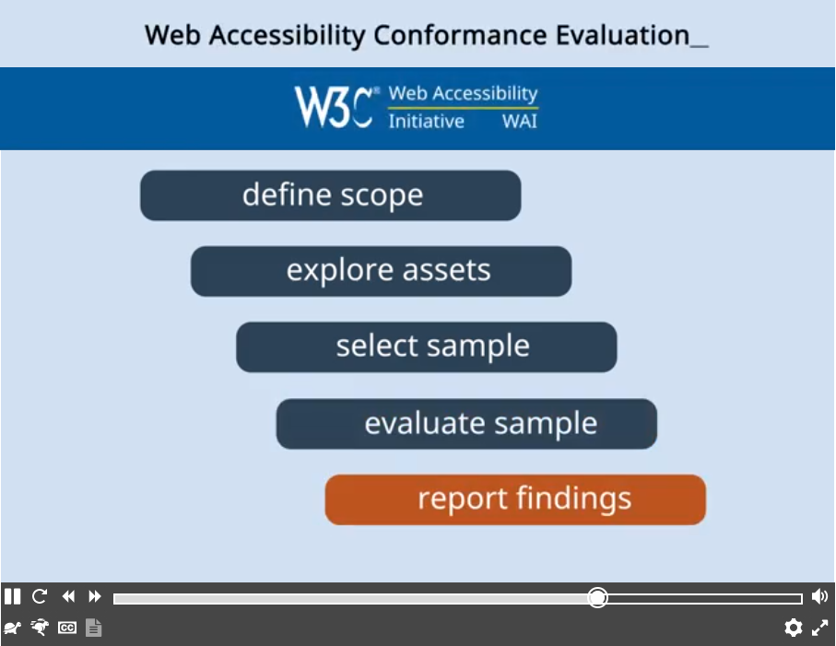
Methodology of web accessibility conformance evaluation
Conformance evaluation determines how well a website conforms to accessibility standards such as Web Content Accessibility Guidelines.
WCAG Conformance Evaluation Methodology, W3C-WAI (video, 2.08 min)
Read more: WCAG-EM Report Tool, W3C
Notes:
Conformance evaluation is done:
as a final check before releasing a product
in order to provide information to potential purchasers of your product
to regularly monitor the accessibility of your website
before procuring a product

Slide 20
Prioritizing accessibility review and remediation
Accessibility prioritization matrix
Prioritizing which content and platforms to review and remediate based on the impact on individuals with disabilities in and outside the organization.
Accessibility severity scale
Assign priority to different bugs based on the significance of the accessibility barrier
Example, Michigan State University Prioritizing Web Content for Accessibility Review and Remediation

Slide 21
Conclusion
In this lesson, we covered the understanding of WCAG .
You learned WCAG success criteria practiced finding WCAG issues.
In the next lesson, you will learn more about accessibility testing tools and strategies.

